Slide 1
Hungry Eats
HungryEats is a web application designed to streamline the process of ordering food from restaurants and eateries. It provides users with a convenient platform to browse menus, add food items to favorites and customize orders.
This application also has the functionality for the admins to add the food items and restaurants so that users can checkout these restaurants for food ordering.

Slide 2
Contents
Abstract
Introduction
Modules
UML Diagrams
Tools and Technologies used
Testcase Templates
Screenshots

Slide 3
Abstract
Hungry Eats is a web application where users can find different cuisines in a single app.
Admin adds the food and restaurant details, and the users can place the orders by registering to the system, and also they can add the food items to favourites section.

Slide 4
Introduction
Through this Hungry Eats application user will be able to register in the system. A registered user should be able to login to the system, and can place the orders, by adding the food items to the cart.If the user wants he can also add the food items to favourites through favourite service and the same will be displayed in the favourites section. User can check his recent oders in the recent orders section.

Slide 5
Modules
Registration module
Restaurant module
Favourites module
Order module

Slide 6
Registration Module:
In registration module, we have login and registration pages, where the user will be able register their details and then login to the system.
Restaurant Module:
In restaurant module, we have food details form and restaurant details form, where the admin can add the restaurant and food details.

Slide 7
Order Module :
In order module, we have cart details and the order Where the user can add the food items to cart and can place the order.
Favourites Module :
In favourites module, we have the favourite button, after successful login user can add the food items to favourites by clicking the favourites button. They can view their favourite list and also they can remove the items from favourites.

Slide 8
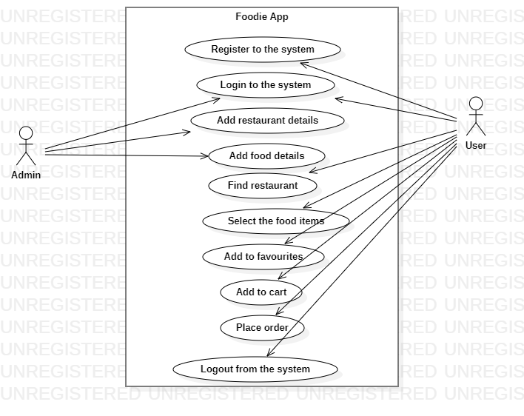
UML Diagram
Usecase Diagram:
Fig: Usecase diagram

Slide 9
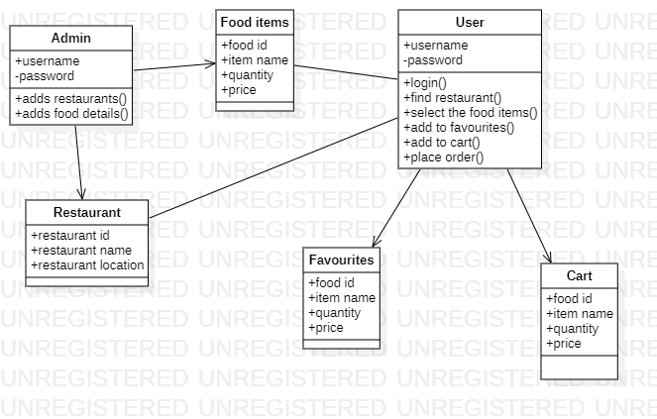
Class diagram

Slide 10
Tools and Technologies Used
VCS : Gitlab
Middleware : Java Spring Boot
Front end : Angular
Data Store : MySQL
Testing : Karma,Jasmine,Junit,Mockito
Containerization : Docker

Slide 11
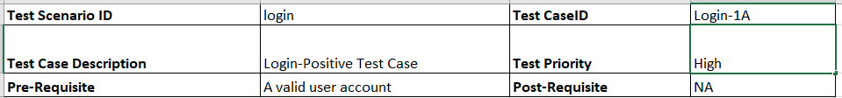
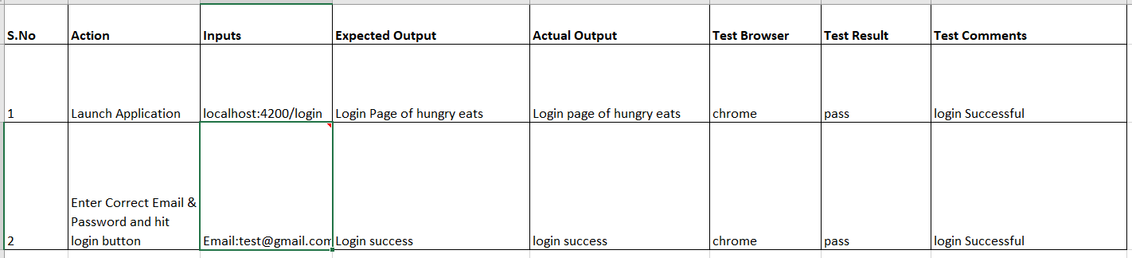
Testcase Template

Slide 12
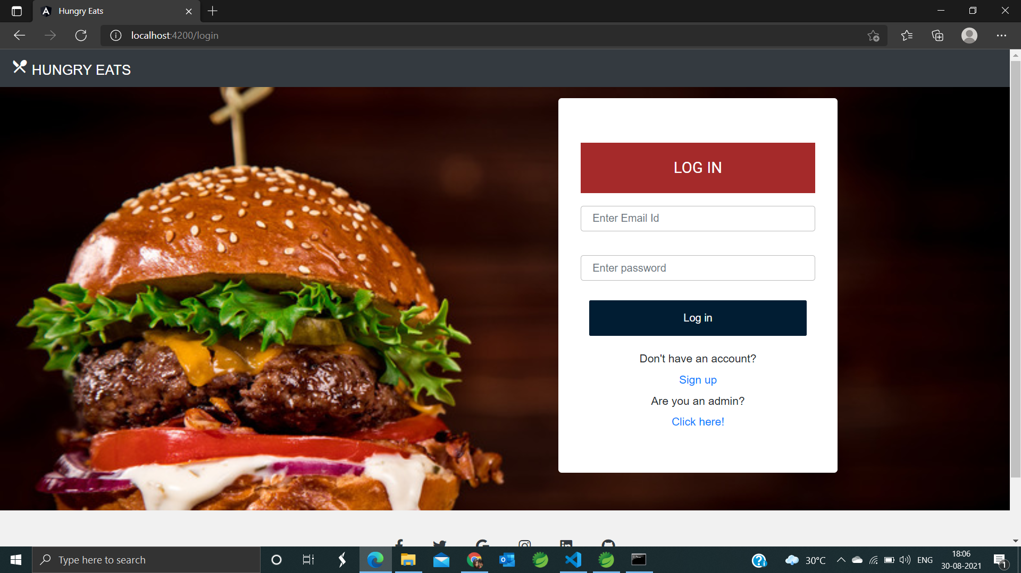
Output Screenshots User Login
Fig: User login page

Slide 13
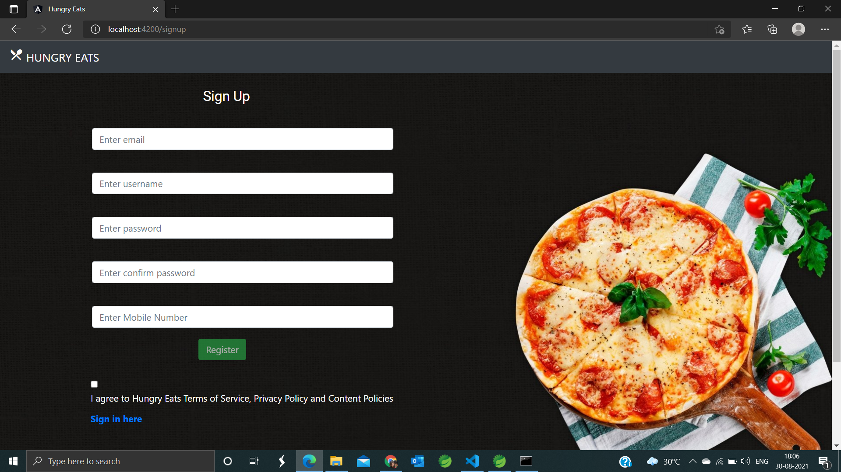
User Registration
fig: User registration page

Slide 14
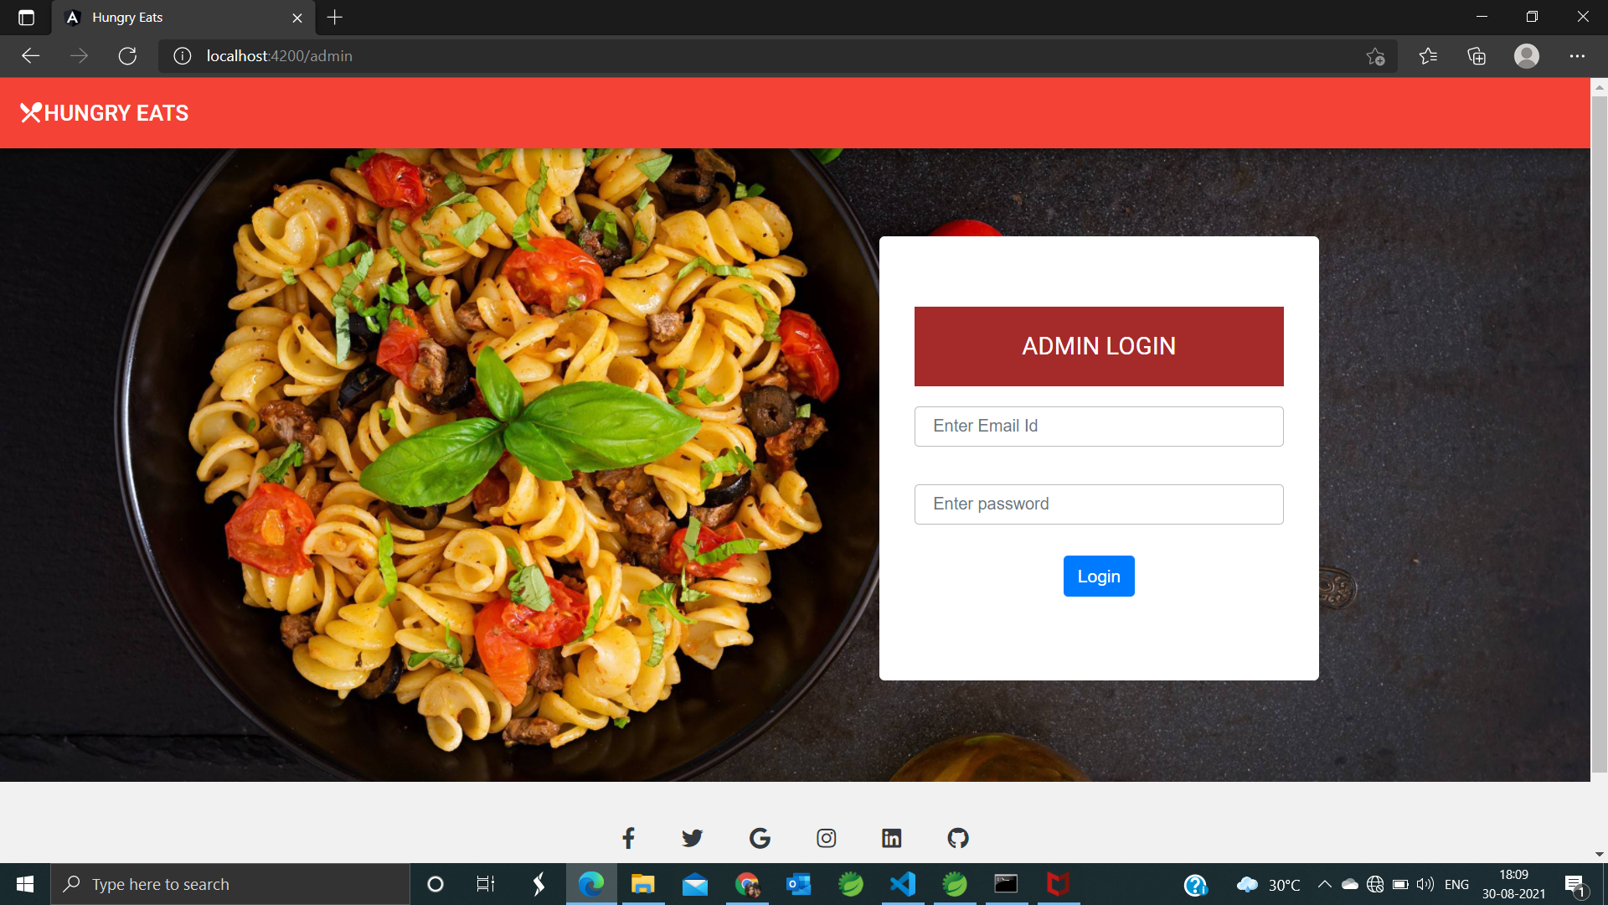
Admin Login
Fig: Admin login page

Slide 15
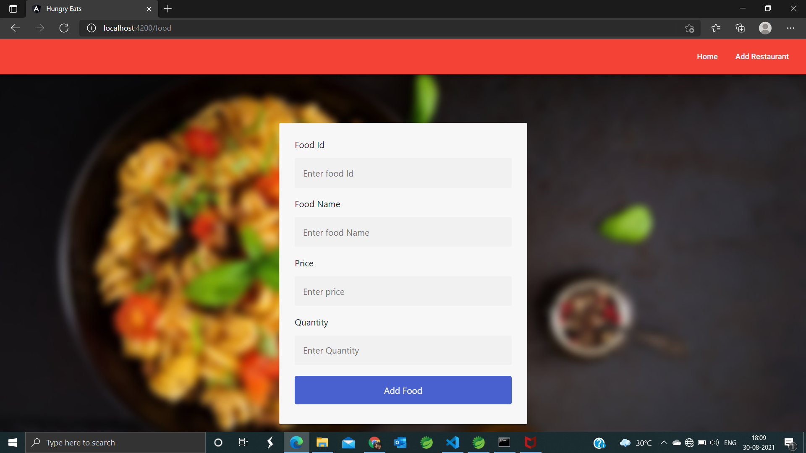
Food
Fig: food details form

Slide 16
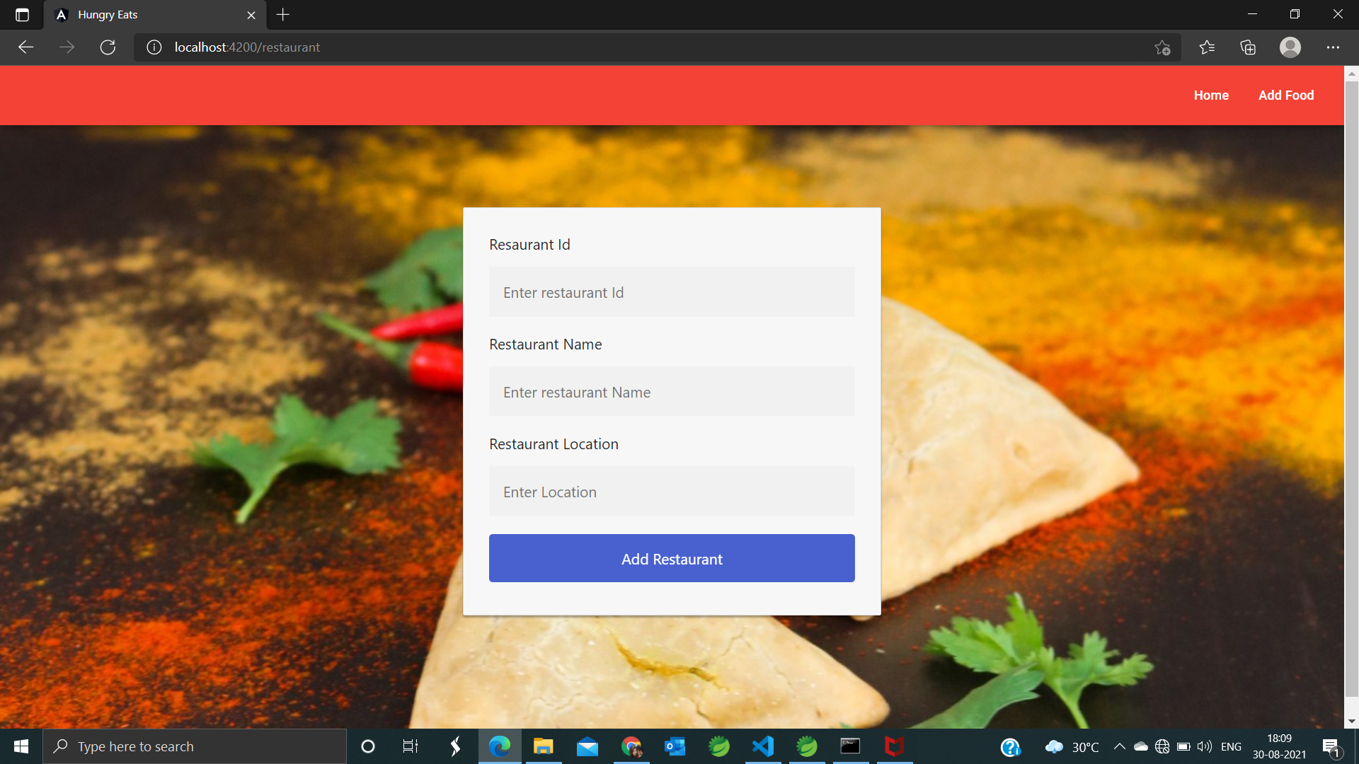
Restaurant
Fig: Restaurant details form

Slide 17
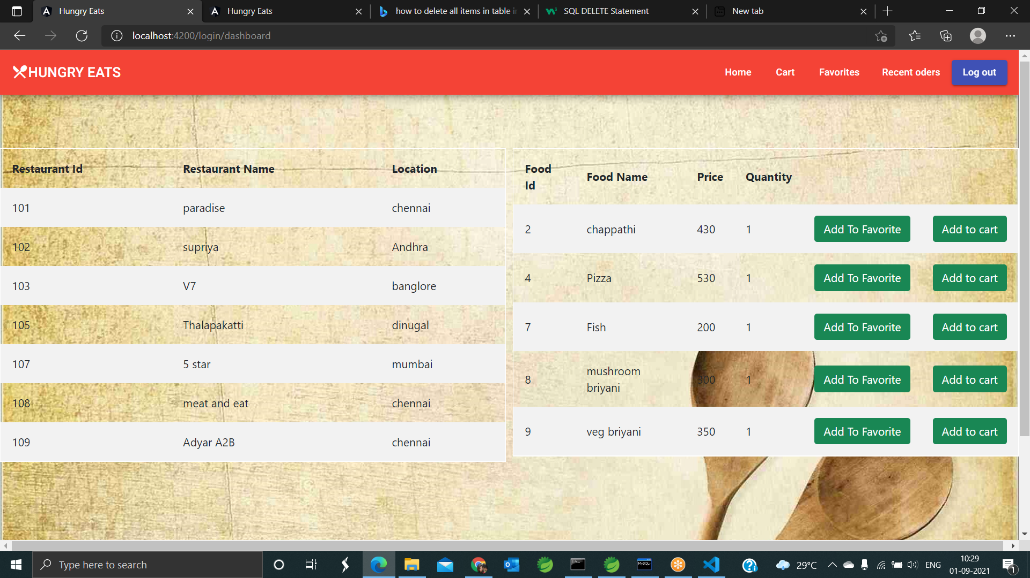
Dashboard
Fig: Dashboard details

Slide 18
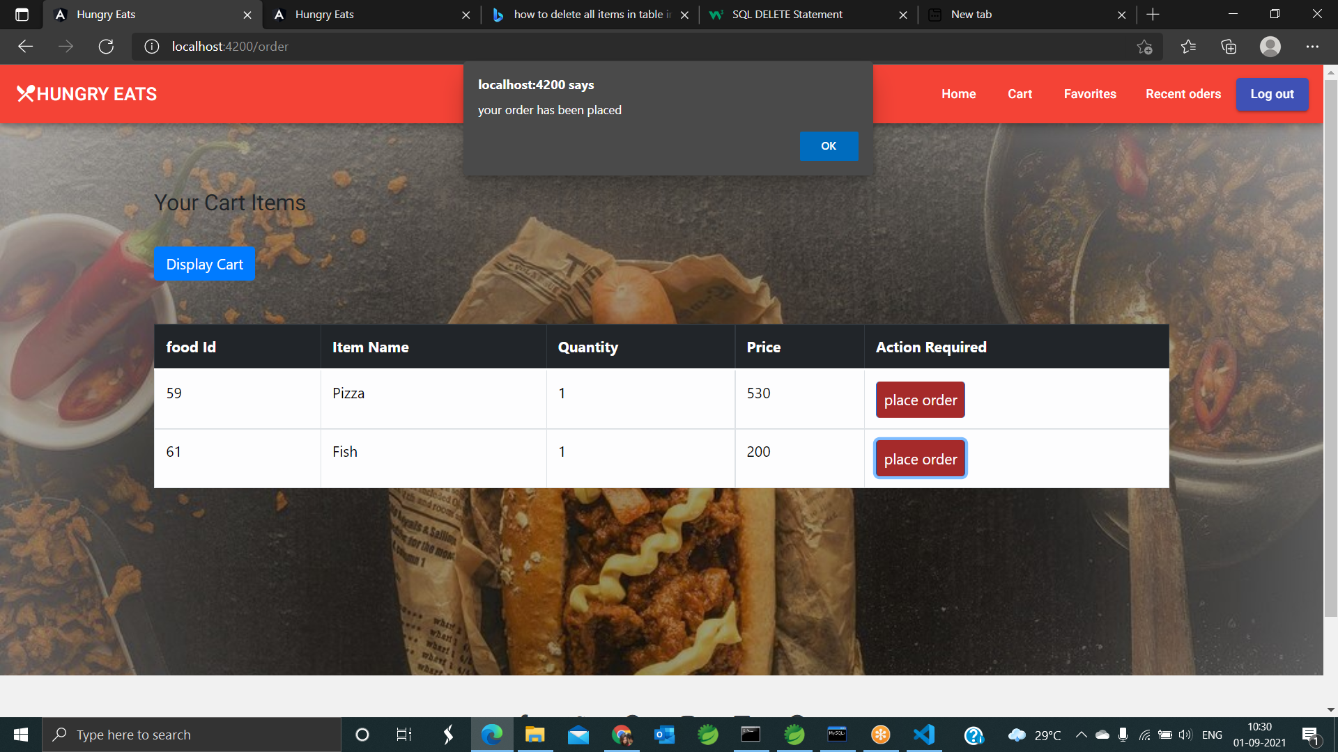
Cart
Fig: Cart details

Slide 19
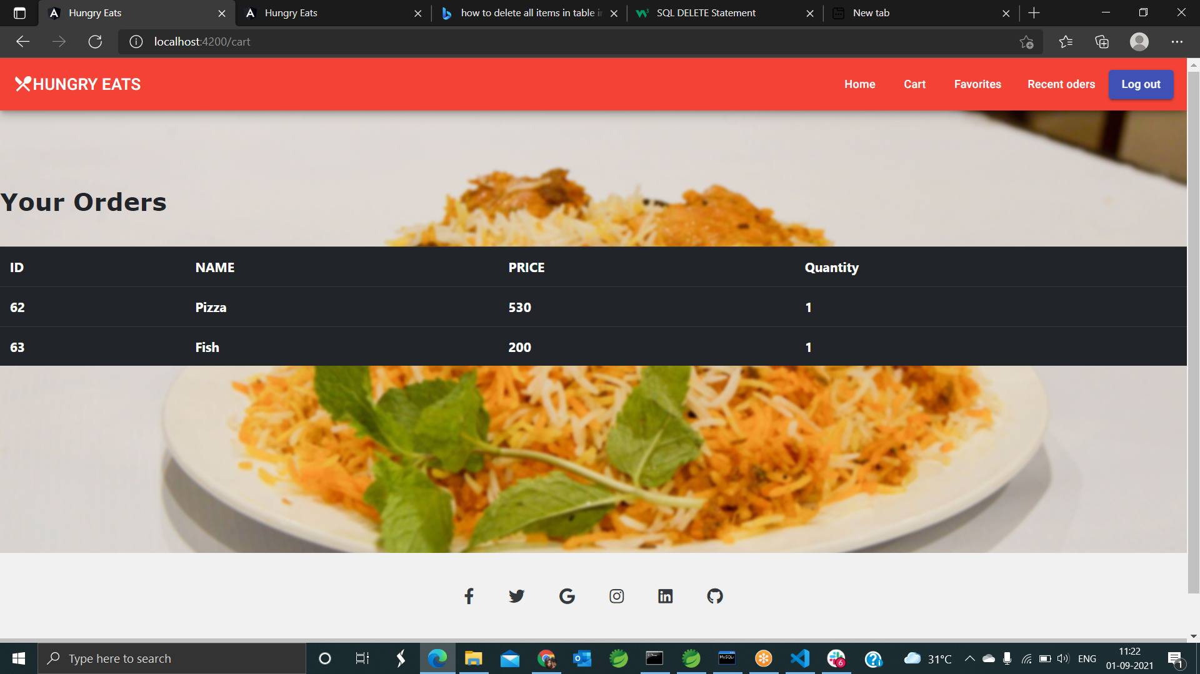
Orders
Fig: Recent orders details

Slide 20
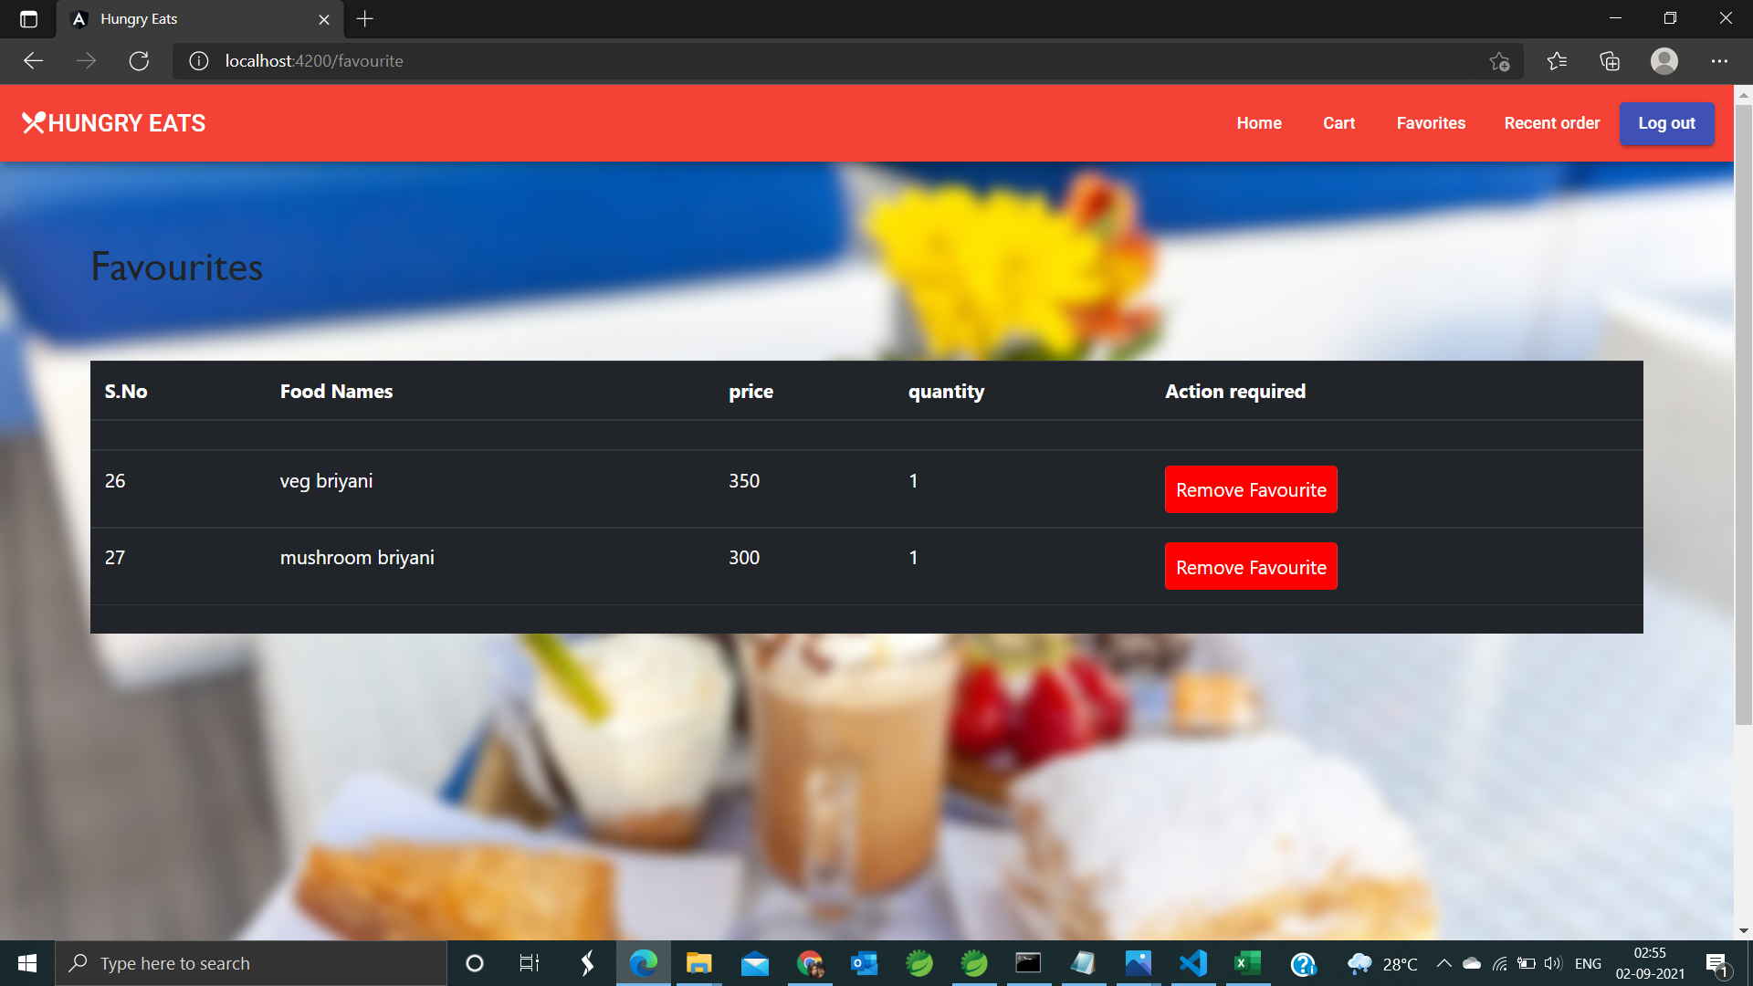
Favourites
Fig: Favourites section

Slide 21
Conclusion
“HUNGRY EATS” is a web application where users can find different cuisines in a single app. Users can register and login to the system and can place the orders. And also if they want they can add the food items to favourites section.

Slide 22
References
https://www.zomato.com/kingman-ks
https://www.swiggy.com/

Slide 23
THANK YOU

